Slide 2
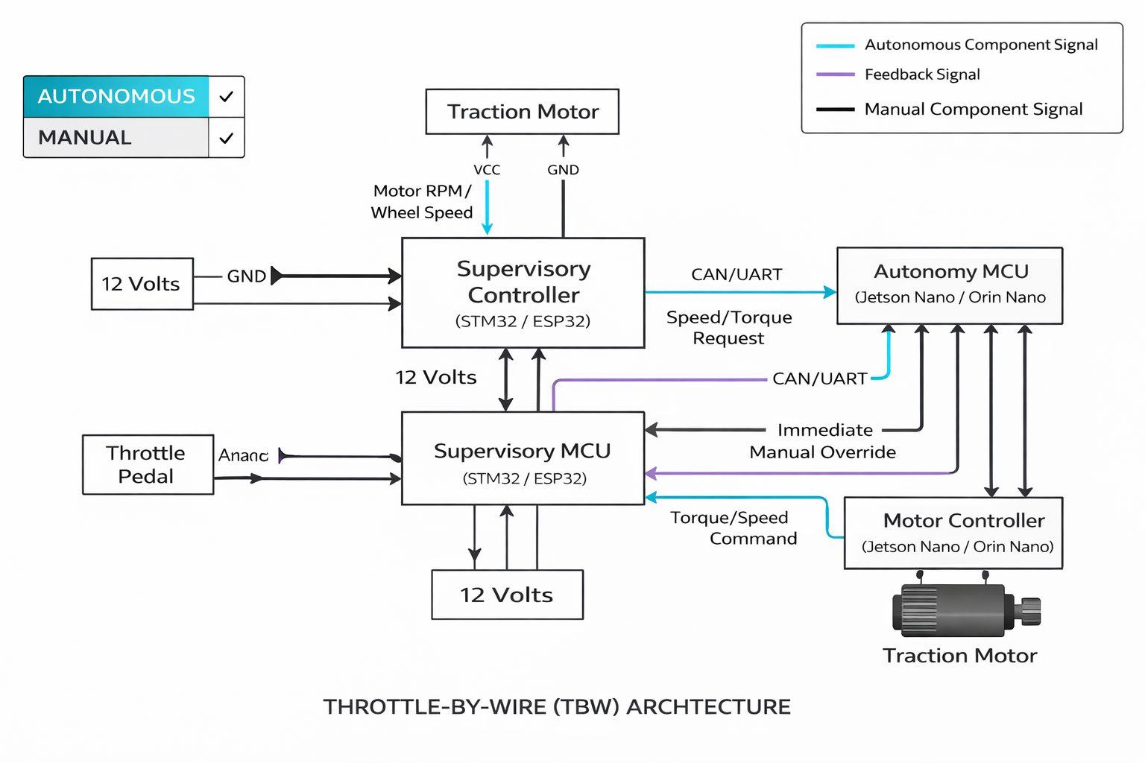
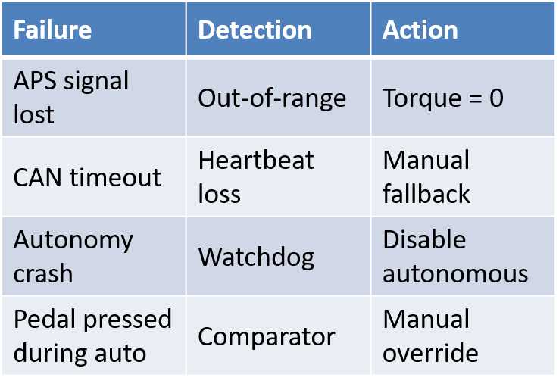
Throttle By Wire
Our throttle-by-wire system introduces autonomy through a supervisory controller while preserving full manual control, ensuring safe torque arbitration and immediate fallback in any fault condition.
Throttle By Wire Architecture
Mode & Switch Logic
IF Autonomous Switch = OFF
→ Manual pedal controls torque
IF Autonomous Switch = ON
AND no fault detected → Autonomous speed controller active
IF Any fault OR driver presses brake → Immediate revert to Manual (0 torque command)
Communication Frequency
Failure Modes & Immediate Mitigation
Control Flow
Desired Speed (from planner)
APS reading: 100–200 Hz
Torque command to inverter: 50–100 Hz
Autonomy → supervisor command: 20–50 Hz
Speed Error = V-ref − V-actual
PID Controller
Torque / Speed Command
Motor Controller

Slide 3
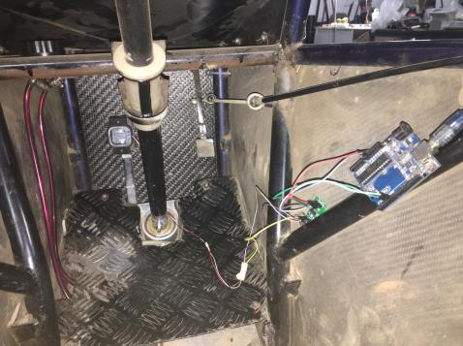
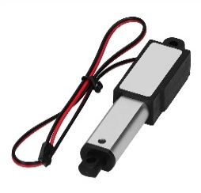
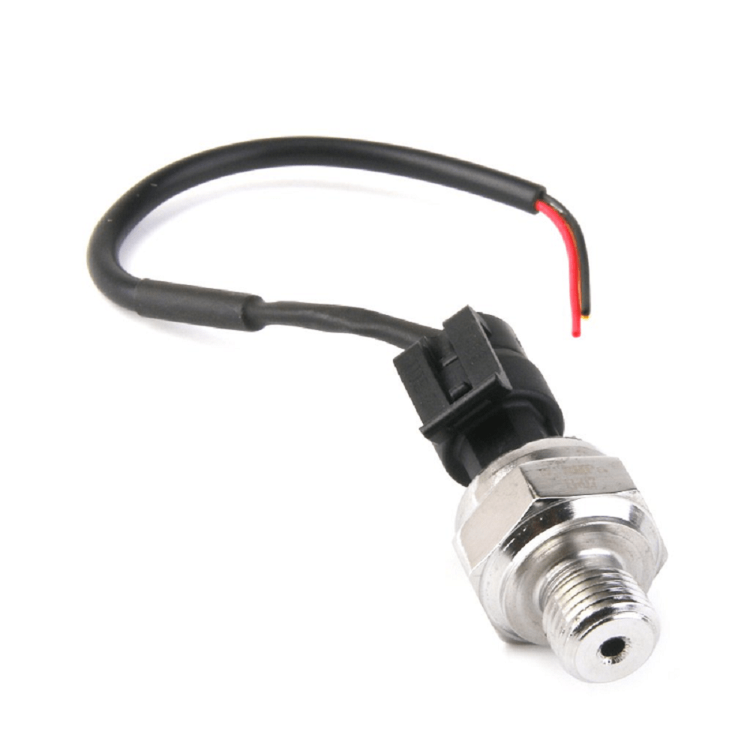
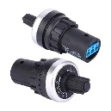
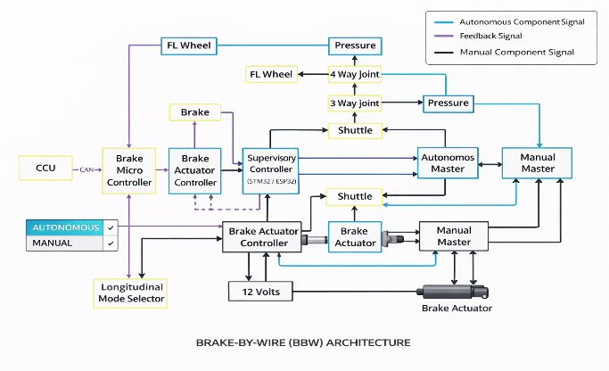
Brake By Wire
The brake-by-wire system actuates the existing hydraulic brake pedal using a linear actuator during autonomous operation, while preserving full manual braking capability and ensuring immediate override and fail-safe retraction in all fault conditions.
Hardware Architecture
Control loop
DETERMINATION OF PEDAL FORCE
Desired Deceleration
↓
Brake Demand (%)
↓
Pedal Position Command
↓
Linear Actuator
↓
Hydraulic Pressure
To calculate force applied by driver on brake pedal to ensure required braking forces calculations using button load cell
Brake Pedal
↑
Linear Brake Actuator
↑
Brake MCU (Supervisory Controller)
↑
Autonomy Stack (Jetson / SBC)
Result: Required Force: 450 N (30–60 kgf)
Actuator Selection for BRAKES
12V Linear Actuator with Position Feedback
Required Force: 300–600 N (30–60 kgf)
Stroke:70-150 mm
Failure Modes & Mitigation
Linear Actuator
Speed:20–50 mm/s
Failure | Detection | Action
Actuator jam | No position change | Disable autonomy
Brake command stuck | Timeout | Retract actuator
Sensor mismatch | Plausibility | Manual-only mode
Power loss | Voltage drop | Pedal returns to driver
Sensors used :
Hardware Architecture
Pressure Transducer
Linear Potentiometer
Works on 5v
Capable about 100 Bar Pressure
Stroke: Upto 150 mm
Voltage Output: 0-5V
3

Slide 4
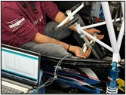
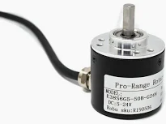
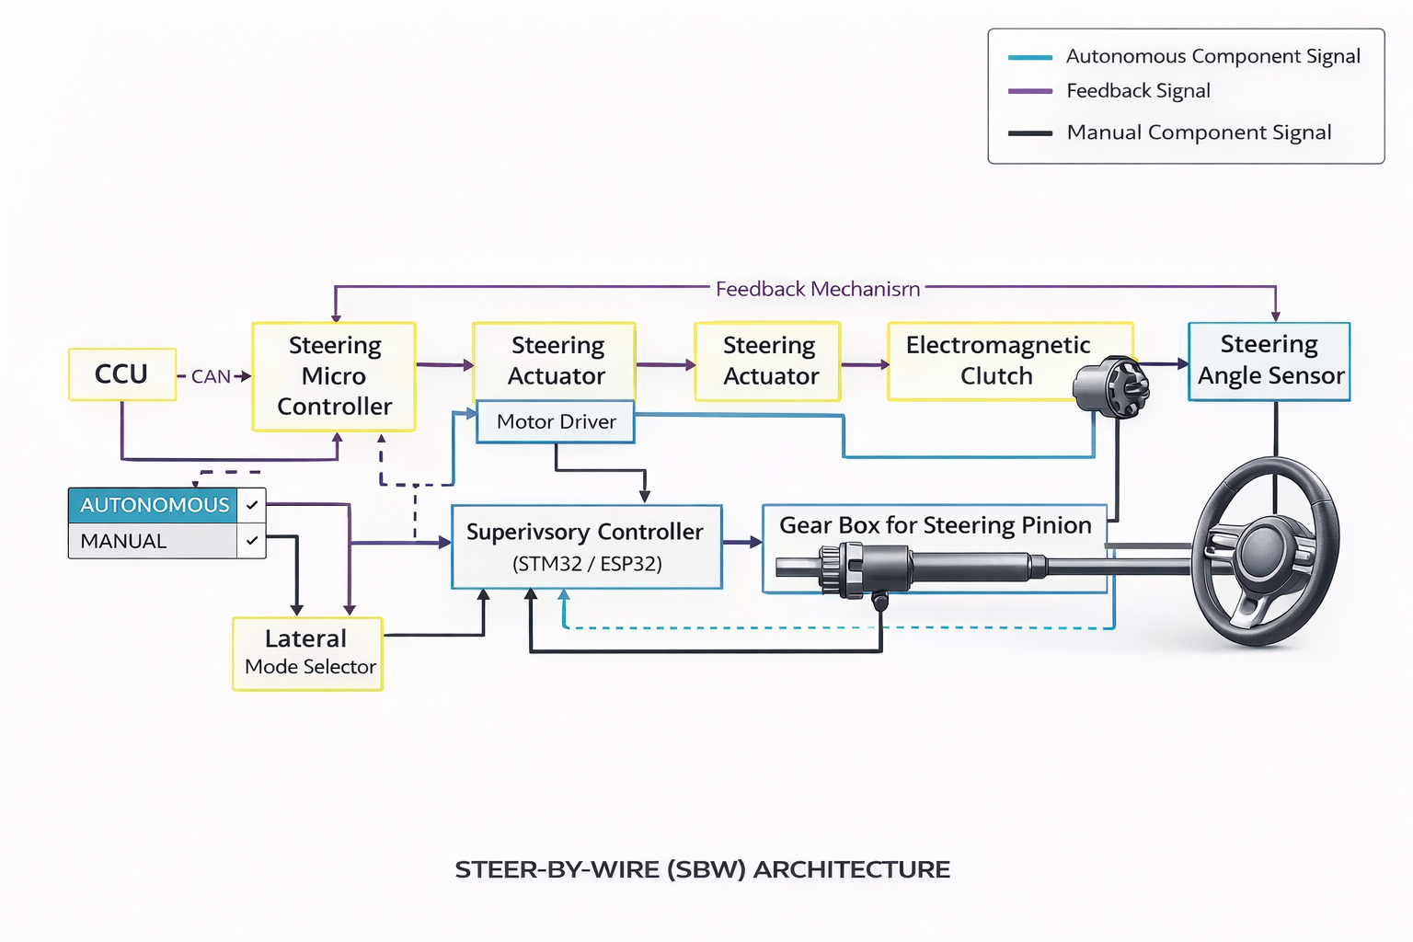
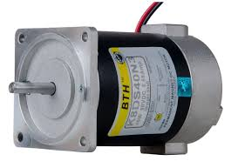
Steer By Wire
Steer-by-wire is implemented as an electric steering assist acting on the existing mechanical steering system, ensuring continuous manual control, immediate driver override, and safe autonomous lateral guidance.
Steering Effort
DC Motor with Gear Reduction
Sensors Used
Hardware Architecture
The values of KPI and Castor angles have been kept for optimum steering effort, returnability and the road feel while also keeping in mind the suspension parameters.
Continuous Torque: 10–15 Nm
Angular speed: 60–120 deg/s
12V Or 24V DC
Peak Torque: 20–30 Nm
Range: ±450°
Resolution: ≥12 bit
Absolute (no homing)
Results: 8.2 KgF using Load cell Setup
Control hierarchy
Desired Path / Lane Center
↓
Desired Steering Angle
↓
Angle Error = θref − θactual
↓
PID / Stanley / Pure Pursuit
↓
Motor Torque Command
Failure Modes & Mitigation
Priority order
`
Failure | Detection | Action
Motor stuck | Encoder mismatch | Disable assist
Sensor failure | Out-of-range | Manual-only
CAN timeout | Heartbeat loss | Neutral assist
Power loss | Voltage drop | Mechanical steering intact
Driver Steering Input:
Autonomous Steering Assist
Steering Hold / Centering

Slide 5
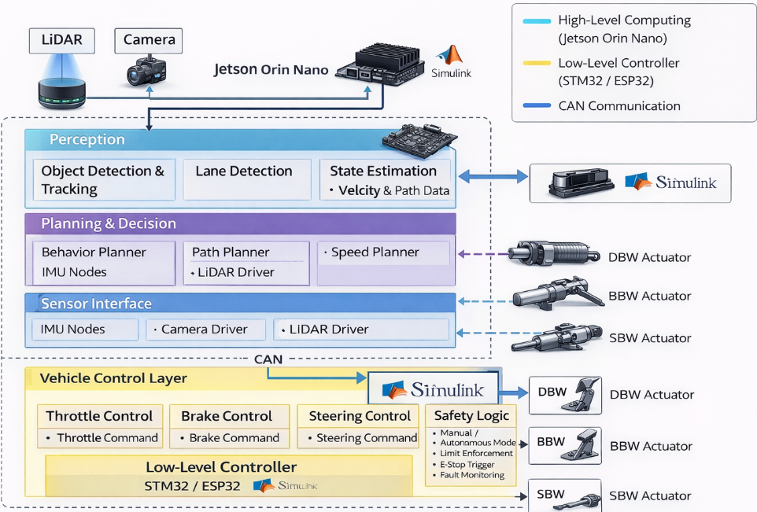
COMPLETE SOFTWARE ARCHITECTURE
The software architecture follows a layered and distributed approach, where high-level autonomy runs on a computing platform while all safety-critical control and arbitration are handled by a dedicated supervisory controller.
High-level architecture
Detailed Block-wise Architecture
Human / Safety Layer
Planning & Decision
Perception
Sensor Interface
Vehicle Control Layer
A. Sensor Interface Layer
Inputs:
Camera (USB / CSI)
IMU
Wheel speed (via MCU)
Steering angle (via MCU)
B. Perception Layer
Modules:
Lane detection (classical + optional ML)
Obstacle detection (vision-based)
Object classification (cones, barriers)
Timing & Frequencies
E. Vehicle Control Layer
C. Localization & State Estimation
Controllers:
Longitudinal control
Brake command
Lateral control
Steering angle control
Throttle PID
Module | Frequency
Camera processing | 20–30 Hz
Lane detection | 20 Hz
Planner | 10–20 Hz
Control commands | 50–100 Hz
Safety watchdog | Continuous
Inputs:
IMU
Wheel speed
Steering angle
Outputs:
Vehicle speed
Yaw rate
Heading estimate
F. Safety & Supervisory Layer
D. Planning & Decision Layer
Mode arbitration (Manual / Auto)
Heartbeat monitoring (SBC ↔ MCU)
Limit enforcement
Emergency stop logic
Fault handling
Sub-modules:
Behavior planner (manual / auto / AEB)
Speed planner
Path planner (lane center tracking)
5
Notes:
D. Planning & Decision Layer

Slide 6
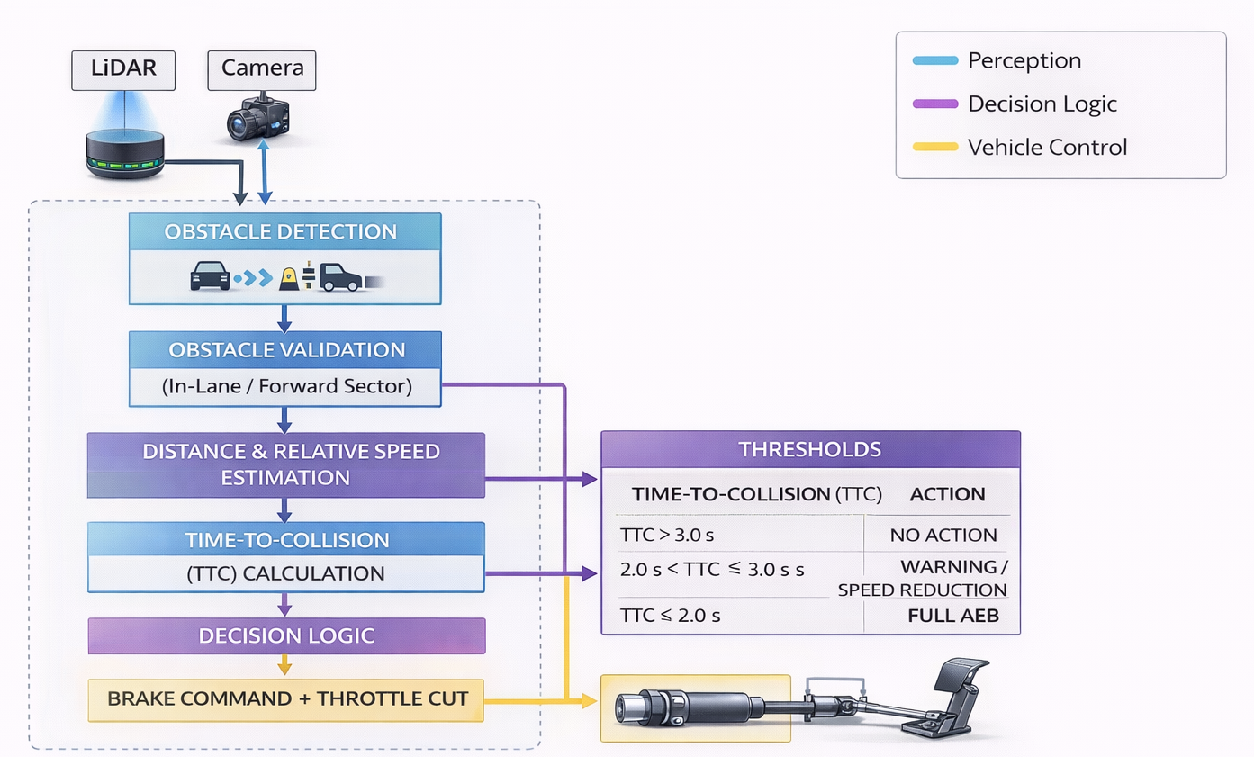
AUTONOMOUS EMERGENCY BRAKING (AEB) & LANE KEEP ASSIST (LKA)
AUTONOMOUS EMERGENCY BRAKING (AEB)
LANE KEEP ASSIST (LKA)
Autonomous Emergency Braking is implemented using LiDAR-based distance estimation and TTC calculation, where the system conservatively overrides propulsion and applies maximum safe braking whenever collision risk exceeds defined thresholds.
Sensor | Role
Camera | Lane / boundary detection (primary)
LiDAR | Boundary validation, edge cases, distance confirmation
IMU + wheel speed | Vehicle state (yaw, speed)
Lane / Boundary Detection
Sensor roles
AEB System
Camera side
Color / edge-based detection (white lines / cones)
Perspective transform (optional)
Region of Interest (ROI) in front of vehicle
LiDAR side
Detect track edges / cones
Filter ground points
Validate camera-detected boundaries
Sensor | Role in AEB
Camera | Obstacle classification & lane context
LiDAR | Accurate distance & TTC calculation
Brake control strategy during AEB
Throttle command = 0
Brake actuator → maximum safe stroke
Regenerative braking disabled or limited
Vehicle brought to standstill
False-positive & failure handling
Time-To-Collision (TTC)
TTC=vd​
d = distance to obstacle (LiDAR)
v = vehicle speed (wheel speed + IMU)
Failure | Action
LiDAR failure | Disable AEB
Camera failure | AEB using LiDAR only
Controller fault | Manual braking only
CAN timeout | Throttle cut + brake safe
Lateral error calculation
Errors used:
Lateral offset (eᵧ): distance from lane center
Heading error (e_ψ): difference between vehicle heading and lane direction

Slide 7
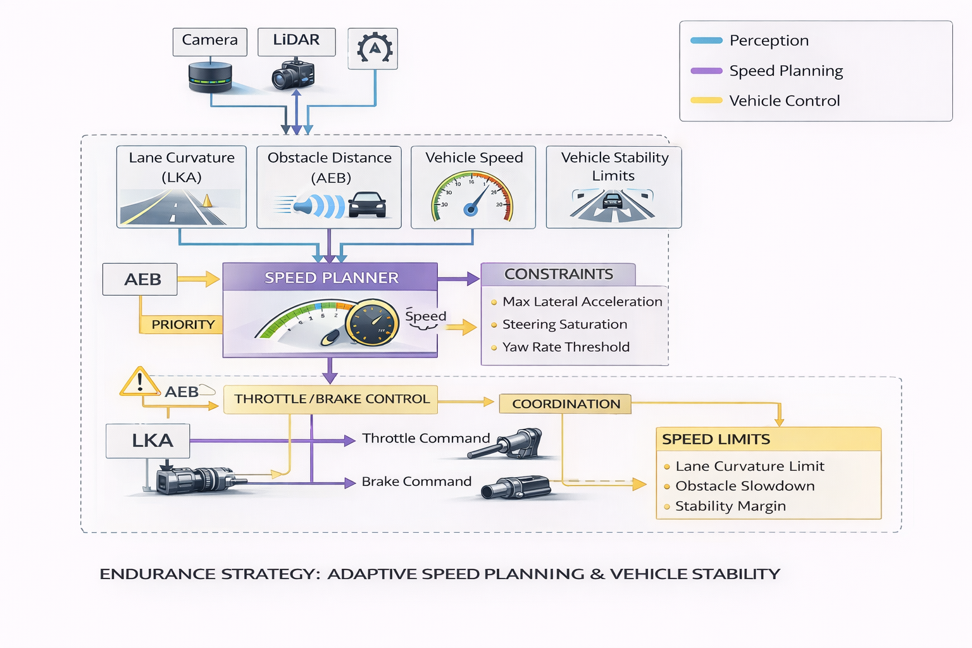
ENDURANCE
Fault handling
Endurance Logic
Condition | Action
Lane confidence low | Reduce speed
Sensor uncertainty | Conservative speed
Steering saturation | Speed reduction
CAN delay | Hold last safe speed
The endurance strategy adaptively regulates vehicle speed based on lane curvature, obstacle proximity, and stability constraints, ensuring reliable and safe completion of the track while coordinating with LKA and AEB functions.
Control execution
Longitudinal control
Desired speed → throttle / brake controllers
Smooth acceleration & deceleration
Lateral control
LKA generates steering
Endurance limits steering rate indirectly via speed
Endurance Logic Inputs
Adaptive Speed Planning
Lane curvature (from LKA)
Vehicle speed (IMU + wheel speed)
Obstacle distance (LiDAR)
Steering angle & yaw rate
Mode status (manual / autonomous)
Straight track → higher speed
Sharp turn → lower speed
Obstacle detected → speed reduced
High steering demand → speed reduced

Slide 8
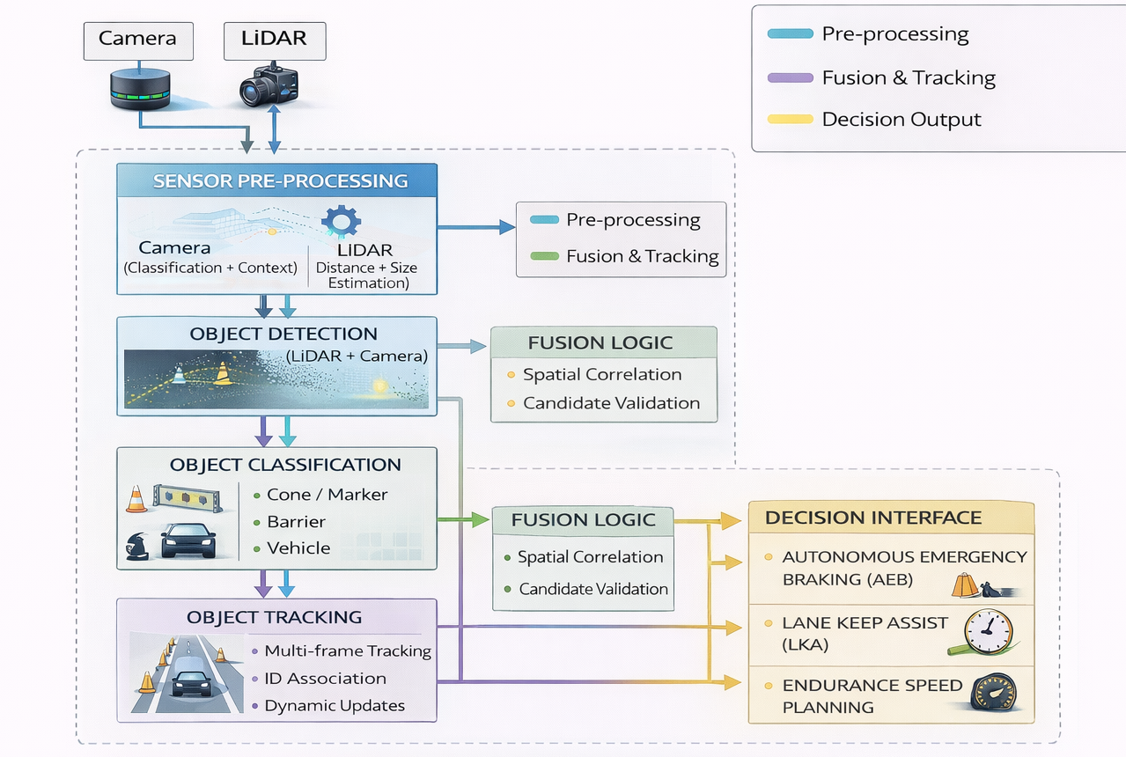
OBJECT DETECTION & CLASSIFICATION
Sensors
Object detection and classification are implemented using a camera–LiDAR fusion approach, where LiDAR ensures reliable distance estimation and the camera provides semantic classification, enabling safe integration with AEB, LKA, and endurance strategies.
Sensor | Purpose
Camera | Object classification & visual context
LiDAR | Distance, size, and position estimation
Failure handling
LiDAR-based object detection
Failure | Action
Camera failure | LiDAR-only detection
LiDAR failure | Camera-only + reduced speed
Both unreliable | Disable autonomy
CAN delay | Freeze object state
LiDAR processing steps:
Ground plane removal
Point clustering
Bounding box generation
Outputs:
Object distance
Object width
Object relative position
Integration with other systems
Object tracking
LKA
Ignore objects outside lane
Use objects to validate lane boundaries
AEB
Closest in-lane object
Distance → TTC → braking
Tracking method:
ID-based tracking
Nearest-neighbor association
Multi-frame confirmation
Endurance
Obstacle presence → speed reduction

Slide 9
FAILURE ANALYSIS & MITIGATION
Failure analysis is implemented across perception, computation, communication, and actuation layers, where any anomaly immediately forces the system into a conservative safe state with propulsion cut and braking prioritized.
Failure Detection Mechanisms
Failure Classification
System-Level Safe State
Common detection methods used across the system:
Sensor health checks (timeout, confidence)
Cross-sensor plausibility (Camera ↔ LiDAR)
Heartbeat monitoring (Jetson ↔ MCU over CAN)
Range & saturation checks (actuators)
Watchdog timers (MCU & SBC)
Perception Failures
Computation / Software Failures
Communication Failures
Actuation / Hardware Failures
Throttle command = 0
Brake system = Safe braking / stop
Steering assist = Disabled
Mode = Manual only
Driver alerted (visual / buzzer)
Perception Failures
Failure → Detection → Mitigation
Actuation / Hardware Failures
Failure | Detection | Mitigation
Camera failure | Confidence ↓ / no frames | LiDAR-only mode + speed reduction
LiDAR failure | Timeout / no scan | Camera-only mode + disable AEB
Lane lost | Lane confidence < threshold | Reduce speed + reduce steering assist
Sensor mismatch | Camera–LiDAR disagreement | Conservative braking / stop
Computation / Software Failures
Failure | Detection | Mitigation
Throttle stuck | Position mismatch | Torque = 0
Brake actuator fault | No position change | Manual braking only
Steering motor fault | Encoder mismatch | Disable assist
Power loss | Voltage monitor | Mechanical systems intact
Communication Failures
Failure | Detection | Mitigation
Jetson crash | CAN heartbeat loss | Disable autonomy + manual only
Planner fault | Invalid command | Command rejected by MCU
Control instability | Limit violation | Clamp command / disengage
Failure | Detection | Mitigation
CAN timeout | Message delay > limit | Throttle cut + brake safe mode
Corrupt data | CRC / range error | Ignore command + fallback

